Slide 1
Parallel Algorithm Design
CS121 Parallel Computing
Spring 2020

Slide 2
Foster’s design methodology
Encourages development of scalable algorithms by delaying machine-dependent considerations until later steps.
I. Foster, Designing and Building Parallel Programs, Addison-Wesley, 1995, available online at http://www.mcs.anl.gov/~itf/dbpp/
Methodology has four steps
Partitioning
Communication
Agglomeration
Mapping

Slide 3
Outline
Overview of Foster’s methodology.
Example using Floyd-Warshall algorithm.
Data partitioning.
Algorithmic partitioning.

Slide 4
Foster’s design methodology

Slide 5
Partitioning
The application must be partitioned into a number of tasks that can execute in parallel.
Data partitioning
The application data is divided into parts and each task operates on a different part of the data.
Need to associate computations with the data.
Also known as domain decomposition.
Algorithmic partitioning
The algorithm is divided into a number of tasks that can execute in parallel.
Need to associate data with the tasks.
This often yields tasks that can be pipelined.
Also known as functional decomposition.

Slide 6
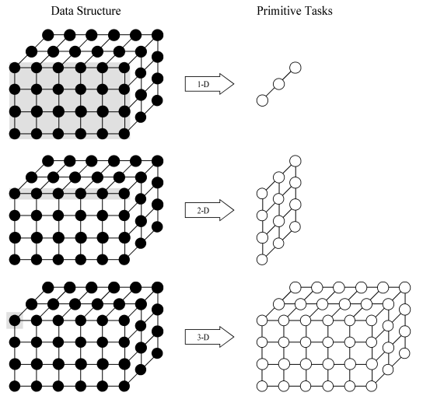
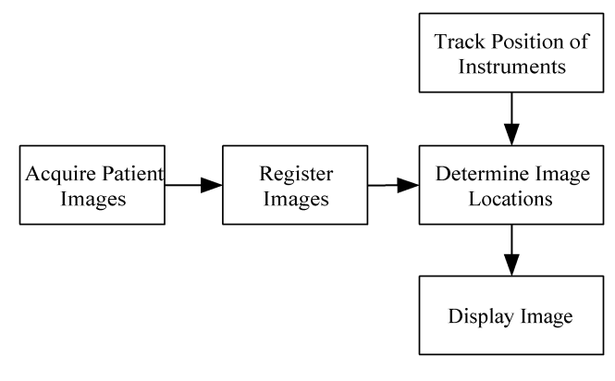
Partitioning
Data partitioning
The application data is divided into parts that can be operated on in parallel.
Algorithmic partitioning
The algorithm is divided into parts that can be executed in parallel.

Slide 7
Partitioning checklist
There should be at least 10x more primitive tasks than processors in the target computer.
Redundant computations and redundant data storage should be minimized.
The primitive tasks should be roughly the same size.
The number of tasks should be an increasing function of problem size.

Slide 8
Communication
Determine what data is passed between tasks.
Two kinds of communication
Local communication: A task needs values from a small number of other tasks (point-to-point),
Global communication: A number of tasks require or contribute data (collective).
Checklist
Communication should be balanced among tasks.
Each task should preferably communicate with only a small group of neighbours.
Tasks should be able to perform communications concurrently, i.e. no bottlenecks.
Task should be able to overlap computations and communication.

Slide 9
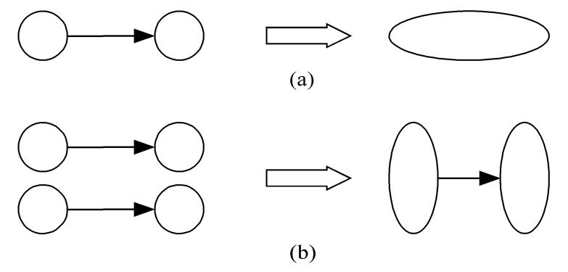
Agglomeration
Grouping tasks into larger (super)tasks.
Goal is to improve performance and simplify programming.
Eliminate communication between primitive tasks that are agglomerated into one task.
Combine groups of sending and receiving tasks so that fewer but larger messages are sent.

Slide 10
Agglomeration checklist
Locality of the parallel algorithm should increase.
Replicated computations can sometimes replace communications and often take less time.
The amount of replicated data should be small so that it does not affect scalability.
Agglomerated tasks should have similar computational and communication costs.
The number of tasks should be suitable for likely target systems (at least equal to the number of processors).
The modifications to the sequential code should be reasonable.

Slide 11
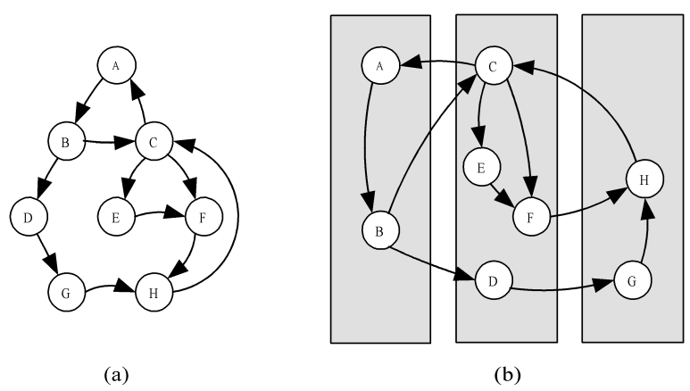
Mapping
Assigning (super)tasks to processors
With a distributed memory system, mapping can be done by the user.
Goals
Balance the load to maximize processor utilization.
Minimize interprocessor communication.
Sometimes two goals conflict. Look for best tradeoff.
If all tasks require the same amount of time, the above mapping would mean the middle processor takes twice as long as the other two.

Slide 12
Mapping checklist
Static task allocation
If tasks have same computation time, can agglomerate tasks to minimize communication and create one supertask per processor.
If tasks have varying computation times, can cyclically map tasks to processors so each processor receives a set of tasks with same average load.
Dynamic task allocation
If tasks are created dynamically, or they have unknown computation times, can allocate dynamically.
Ex Work stealing. Each processor has a work queue. Processors finished with own work queue take tasks from another processor’s queue.
Should ensure the task allocator (manager) is not a bottleneck to performance.

Slide 13
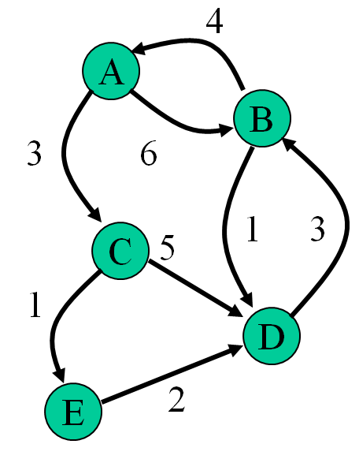
All pairs shortest path problem
Given a weighted directed graph of vertices and edges.
There may be an edge from vertex i to j, but not from j to i.
Edge weight from vertex i to j may be different to from j to i.
Find the shortest path between every pair of vertices.
Applications
Shortest route on a road / communication network.
Efficient solution in a state space graph.

Slide 14
Example
Represent graph using adjacency matrix.
a[i,j] = 0 if i = j.
For i ≠ j, a[i,j] = length of edge from i to j, or ∞ if no edge.
Output matrix of shortest path lengths, or ∞ if no path.
Assume no negative weight cycles for simplicity.
A
B
C
D
E
A
B
C
D
E
A
0
6
3
∞
∞
A
0
6
3
6
4
B
4
0
∞
1
∞
B
4
0
7
10
8
C
∞
∞
0
5
1
C
10
6
0
3
1
D
∞
3
∞
0
∞
D
7
3
10
0
11
E
∞
∞
∞
2
0
E
9
5
12
2
0

Slide 15
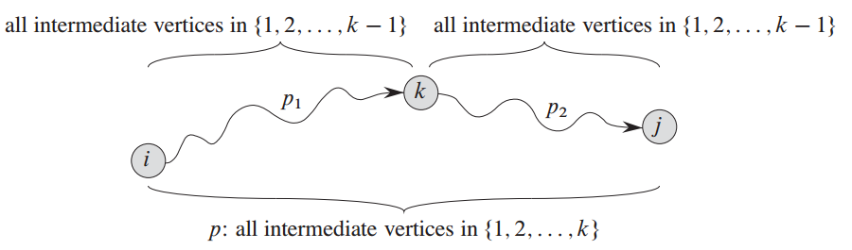
Floyd-Warshall algorithm
Consider the shortest path from i to j using only nodes 1,...,k as intermediate nodes.
Intermediate node is a node on the path besides i and j.
If the path doesn’t exist, indicate its distance by ∞.
Assume a path exists. Then it either uses node k or not.
In the first case, k occurs once in path from i to j.
The path consists of a subpath from i to k using 1, ..., k-1 as intermediate nodes, and a path from k to j using 1, ..., k-1 as intermediate nodes.
In the second case, the path only uses nodes 1,...,k-1.
Source: Introduction to Algorithms, Cormen et al.

Slide 16
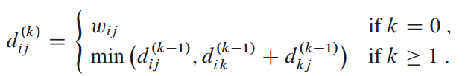
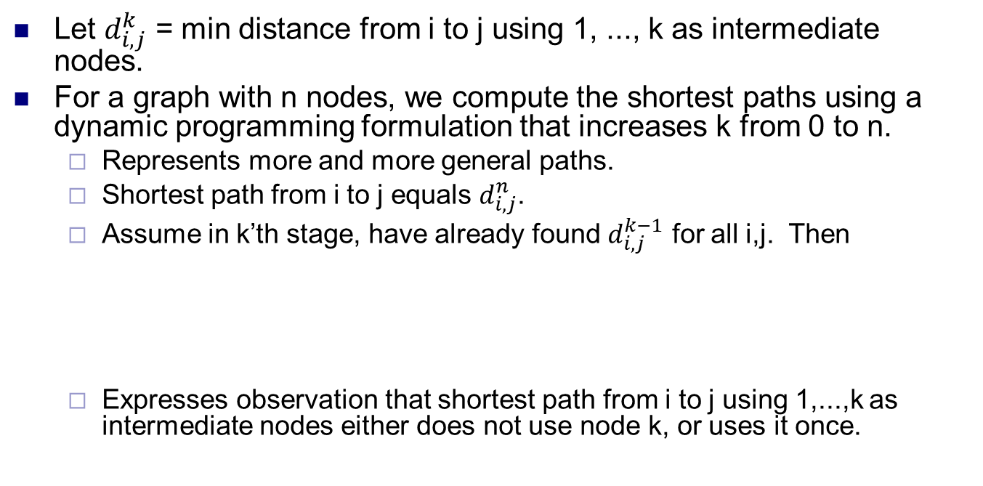
Floyd-Warshall algorithm
Let $d_{i,j}^{k}$ = min distance from i to j using 1, ..., k as intermediate nodes.
For a graph with n nodes, we compute the shortest paths using a dynamic programming formulation that increases k from 0 to n.
Represents more and more general paths.
Shortest path from i to j equals $d_{i,j}^{n}$.
Assume in k’th stage, have already found $d_{i,j}^{k−1}$ for all i,j. Then
Expresses observation that shortest path from i to j using 1,...,k as intermediate nodes either does not use node k, or uses it once.

Slide 17
Parallelization: partitioning
for (k = 0; k < n; k++)
for (i = 0; i < n; i++)
for (j = 0; j < n; j++)
a[i, j] = min(a[i, j], a[i, k] + a[k, j]);
To parallelize this algorithm, observe for each k, all assignments can be done independently.
I.e. a[i,j] and a[i’,j’] can be computed in either order, for all i,i’,j,j’.
a[i,j] depends on a[i,k] and a[k,j].
But a[i,k]=min(a[i,k], a[i,k] + a[k,k]), where a[k,k]=0.
So a[i,k] doesn’t change in iteration k. Similarly for a[j,k].
So no matter when a[i,j] is computed during phase k, it has same value. Same for a[i’,j’]. So a[i,j] and a[i’,j’] are independent.
Parallel algorithm runs n phases sequentially (one for each k). In each phase, all n² assignments done in parallel.

Slide 18
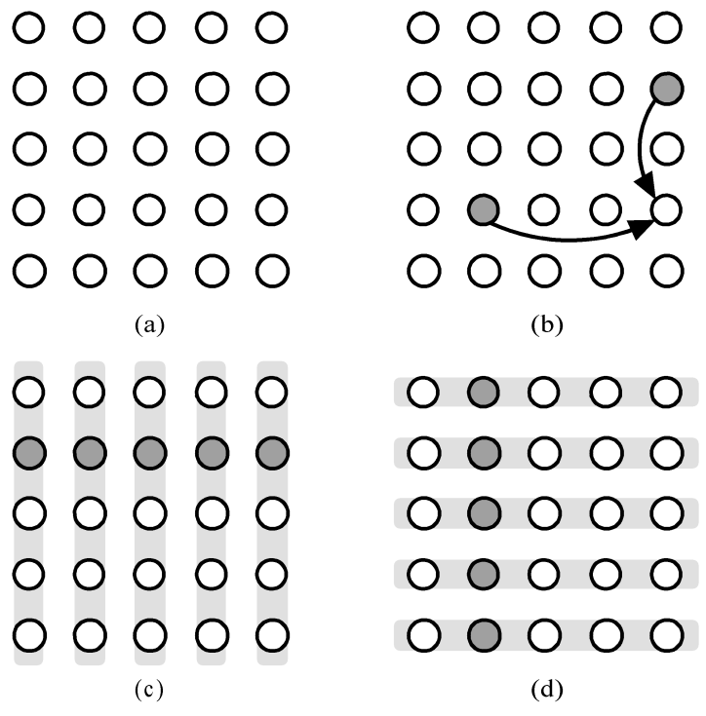
Parallelization: communication
Communication in each phase
Updating a[3,4] when k=1.
In general, every entry in row i needs a[i,k], and every entry in column j needs a[k,j].
The primitive tasks
So in phase k, a[k,j], for each j, broadcasts its value to the j’th column.
Also, a[i,k], for each i, broadcasts its value to the i’th row.

Slide 19
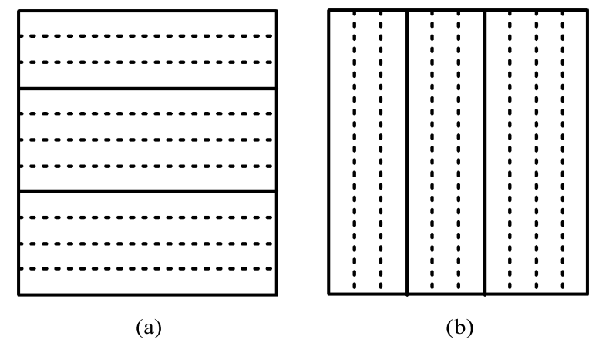
Agglomeration and mapping
Number of tasks is static, always n².
Computation time per task is constant.
Agglomerate tasks to minimize communication.
Create one task per MPI process.
Can choose either (a) row striping, or (b) column striping.
Row striping more convenient in C.
Each process has a strip of rows, avoid communication within same strip (row).
Each process has a strip of columns, avoid communication within same strip (column).

Slide 20
MPI pseudocode
Assume n × n matrix on p processors (n exactly divisible by p), where part[i,j] holds strip of rows of i’th processor.
We’re ignoring code to distribute matrix and collect results.
s = n/p; /* rows in strip */
for (k = 0; k < n; k++) {
root = k/s; /* owner of row */
if (myrank == root) {
offset = k – myrank*s; /* offset of row */
for (j = 0; j < n; j++) /* copy row */
temp[j] = part[offset][j];
}
bcast(temp, n, root, P_{group}); /* broadcast row */
for (i = 0; i < s; i++) /* update strip */
for (j = 0; j < n; j++)
part[i][j] =
min(part[i][j], part[i,k] + temp[j]); }

Slide 21
Analysis of algorithm
Sequential running time t_{s} = O(n³).
Parallel execution
In each iteration of k, there is a communication phase and a computation phase.
Communication phase
Broadcast row to other processors
t_{comm} = t_{startup} + 4 n t_{data}, assuming each element 4 bytes.
Computation phase t_{comp} = cn² / p.
Total time
t_{p} = n (t_{startup} + 4 n t_{data} + cn² / p ) = O(n² + n³ / p).
Speedup
t_{s} / t_{p} = O(n³) / O(n²+n³/p) = O(p).

Slide 22
Data partitioning
Simple data partitioning
Divide data into parts of fixed size based on data size and number of processors.
Cost includes computation cost, and communication cost for data distribution and collection.
Divide and conquer
Recursively divide data into smaller and smaller parts, until a small enough size is reached.
Each part solved on a processor.
Number of parts produced not known a priori.
This results in a tree structure with a number of levels.
Better load balancing, solution quality, but higher overhead.

Slide 23
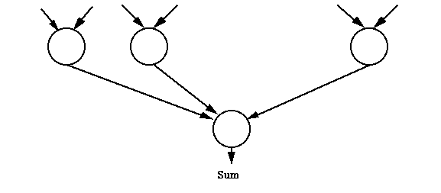
Sum of numbers
To add a list of n numbers, divide it into sublists that are added in parallel by different tasks and the results are then combined.
Initially master holds all values. It scatters values to slaves.
Convenient to have one task (sublist) per processor.
x₀ … x_{n/p -1}
x_{n/p} … x_{2n/p -1}
x_{(p-1)n/p} … x_{n -1}
Master P₀ and slaves P_{i} (1 ≤ i < p)

Slide 24
MPI pseudocode
Assume for simplicity n is divisble by p.
s = n/p; /* size of sublist */
/* scatter list to slaves (incl. master) */
scatter(numbers, part, s, P₀, P_{group});
res = 0;
for (j=0; j<s; j++) /* add sublist */
res = res + part[j];
}
/* add results from slaves (incl. master) */
reduce(res, &sum, ADD, P₀, P_{group});

Slide 25
Analysis
x₀ … x_{n/p -1}
x_{n/p} … x_{2n/p -1}
x_{(p-1)n/p} … x_{n -1}
Sequential execution
Time t_{s} = n - 1
Parallel execution
Phase 1: send data to slaves (collective)
t_{comm1} = t_{startup} + n t_{data}
Phase 2: computation in slave
t_{comp1} = n / p - 1
Phase 3: receive results from slaves (collective)
t_{comm2} = t_{startup} + p t_{data}
Can make more efficient using reduction tree.
Phase 4: computation in master
t_{comp2} = p - 1
Total: t_{p} = p + n / p - 2 + 2t_{startup} + (p + n) t_{data} = O(n / p) + O(p + n).
No speedup over sequential execution, due to need to transfer data in O(n) time.

Slide 26
Numerical integration
Compute area under curve given by f(x) for x∈[a,b].
Split area into small intervals of size δ and give a number of consecutive intervals to each processor.
There are n=(b-a)/δ intervals.
If there are p processors, give n/p intervals to each processor.
Compute area of each interval using trapezoid approximation.
Smaller δ leads to higher n and better approximation.

Slide 27
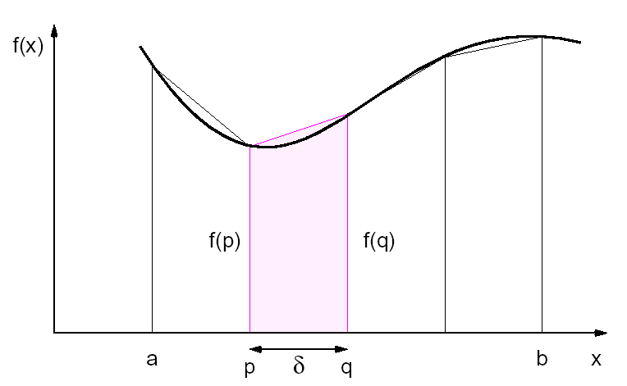
MPI pseudocode
s = (b - a) / p; /* size of region */
d = (b - a) / n; /* size of interval */
low = a + s*myrank; /* my region low */
high = low + s; /* my region high */
area = 0.0;
for (x=low; x<high; x = x + d)
area = area + 0.5*(f(x) + f(x+d))*d;
/* add partial results from slaves */
reduce(area, &integral, ADD, P₀, P_{group});
Only need to transfer final value from each processor.

Slide 28
Analysis
Sequential execution
Time t_{s} = c*n, where c is time for one interval.
Parallel execution
Phase 1: computation in slave
t_{comp1} = c*n / p
Phase 2: receive results from slaves (reduce)
t_{comm} = t_{startup} + p t_{data}
Phase 3: computation in master
t_{comp2} = p - 1
Total: t_{p} = c*n / p + p - 1 + t_{startup} + p t_{data} = O(p +n / p).
O(p) speedup over sequential, because only needed O(p)time for communication.

Slide 29
Divide and conquer
Subdivide a problem into smaller parts until parts are small enough to solve directly.
f(problem)
{
if (size(problem) > k) { /* threshold k */
divide(problem, part0, part1);
res0 = f(part0); /* recursive call */
res1 = f(part1); /* recursive call */
res = combine(res0, res1) /* combine */
}
else /* solve directly if small enough */
res = solve(problem)
return (res);
}

Slide 30
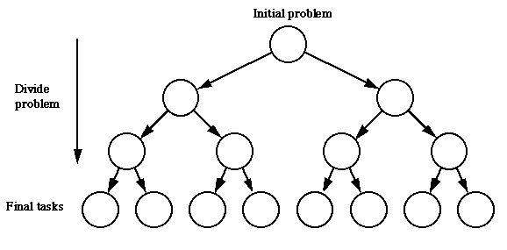
Tree representation

Slide 31
Sum of numbers
int add(int *numbers, n)
{
if (n > 2) {
s = n/2;
res0 = add(numbers, s); /* add 1st part */
res1 = add(&numbers[s], n-s); /* add 2nd part */
res = res0 + res1;
}
else if (n == 2)
res = numbers[0] + numbers[1];
else /* n == 1 */
res = numbers[0];
return (res);
}

Slide 32
Parallel divide and conquer
Subdivide problem into smaller parts until each part small enough to solve on separate processor.
Divide phase is executed in parallel.
Final small tasks are executed in parallel.
Combine phase is executed in parallel.
Still uses a recursive formulation.
Assignment
Each node in the tree structure can be assigned to a separate processor.
Better to reuse processors at different levels of the tree.

Slide 33
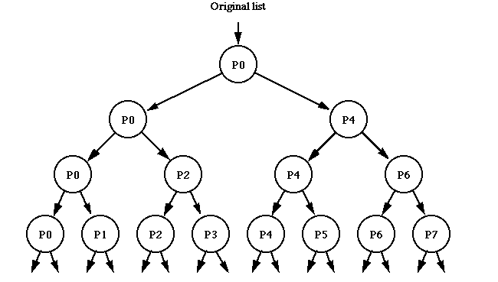
Divide phase

Slide 34
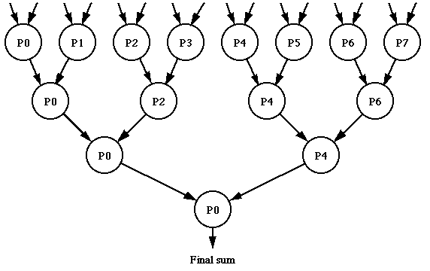
Combine phase

Slide 35
Parallel sum of numbers
Sum n numbers by divide and conquer with p processors.
Recurse until adding at most 2 numbers, i.e. need n/2 ≤ p ≤ n.
int main(int *numbers) {
/* turn off rightmost set bit in myrank */
recv_from = myrank & (myrank – 1);
/* isolate rightmost set bit */
recv_count = myrank & (-myrank);
if (myrank == 0)
res = add(numbers, n, myrank);
else { recv(numbers, recv_count, recv_from);
res = add(numbers, recv_count, myrank);
send(res, 1, recv_from);
}
return res;
}
int add(int *numbers, int count, int rank) {
if (n > 2) {
s = count / 2;
/* send half numbers to slave */
send(&numbers[s], count-s, rank+s);
/* calculate first part myself */
res0 = add(numbers, s, rank);
/* get result from slave */
recv(&res1, 1, rank+s);
res = res0 + res1;
}
else if (n == 2)
res = numbers[0] + numbers[1];
else /* n == 1 */
res = numbers[0];
return (res);
}

Slide 36
Sum of numbers
If p < n/2, we can assign a sublist of n/p numbers to each processor.
/* list of size n on p processors */
int add(int *numbers, n, p)
{
if ((n > 2) && (p > 1)) {
/ * continue to divide */
… …
}
else {
/ * add numbers sequentially */
… …
}
return (res);
}

Slide 37
Analysis
Assume for simplicity both n and p are powers of 2.
Parallel execution
Phase 1: Divide (log p steps, message size halves each step)
t_{comp1} = log p
t_{comm1} = (t_{startup} + (n / 2) t_{data}) +
(t_{startup} + (n / 4) t_{data}) +
(t_{startup} + (n / p) t_{data})
t_{comm1} = (log p) t_{startup} + (n (p - 1) / p) t_{data})
t_{data} terms form geometric series n (¹/₂ + ¹/₄ + ¹/₈ + … )

Slide 38
Analysis
Parallel execution
Phase 2: computation of final tasks
t_{comp2} = n / p
Phase 3: Combine (log p steps, but message size 1)
t_{comm3} = (log p) (t_{startup} + t_{data})
t_{comp3} = log p
Total: t_{p} = n / p + 2 log p + 2 (log p) t_{startup} + (n (p - 1) / p + log p) t_{data} = O(n) + O(log p) + O(n / p)
No speedup due to data distribution time.

Slide 39
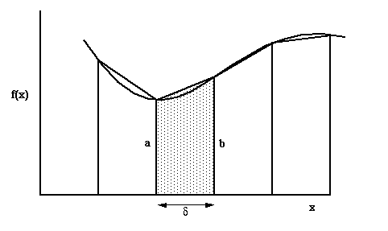
Numerical integration
Using a fixed size interval may not give accurate results as different intervals may give different errors.
p
q

Slide 40
Adaptive quadrature
Use divide and conquer to improve accuracy.
Divide region into two intervals.
Continue to subdivide each interval in two until error is small enough.
Some regions divided more finely than others.
Algorithm adapts to shape of curve.
Can represent subdivisions using a tree.
But tree is not a complete binary tree.
Assigning regions to processors is a load balancing problem. More on this in later lecture.

Slide 41
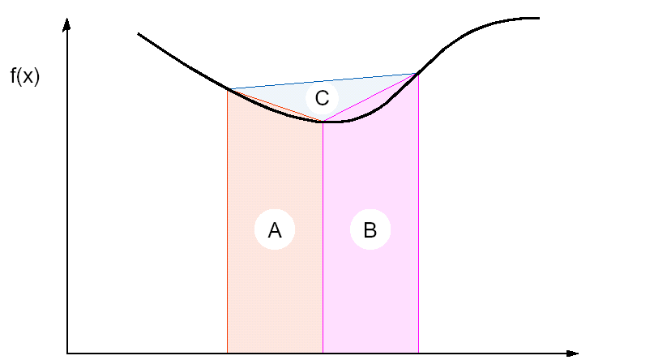
Adaptive quadrature
Terminate when two successive approximations are close enough.
C is sufficiently small.
Or equivalently, A+B is approximately equal to area of large trapezoid.

Slide 42
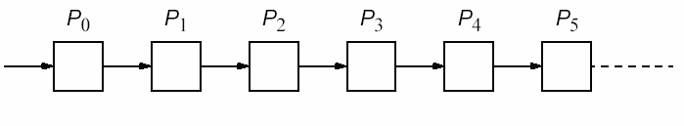
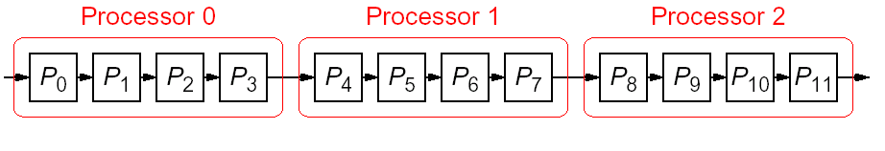
Algorithmic partitioning
Divide an algorithm into several parts, each taking turns processing the data.
One example is pipelined computations.
The problem is divided into a sequence of steps.
The steps must be executed one after another.
Each step is executed by a separate task.
If number of stages in pipeline is greater than number of processors, assign group of steps to each processor.

Slide 43
Example: sum of sequence
Power series for sin θ = θ - θ³/3! + θ⁵/5! - θ⁷/7! + …
The loop could be unfolded to give.
r = theta;
sum = theta;
for (i=1; i < p; i++) {
r = – r*theta*theta/(2*i*(2*i+1));
sum = sum + r;
}
sum = theta;
sum = sum - theta³/3!;
sum = sum + theta⁵/5!;
sum = sum - theta⁷/7!;
…

Slide 44
Pipeline for unfolded loop
Use as many stages (tasks) as required by the precision of the result.
Can pass θ, partial product and partial sum to next processor in pipeline.
More details in later slide.
θ
θ-θ³/3!
θ-θ³/3!+θ⁵/5!
θ-…±θ^{2p-1}/(2p-1)!
P₀
P₁
P₂
P_{p-1}

Slide 45
Types of pipelines
Assuming problem can be divided into a series of sequential tasks, pipelined approach can provide increased execution speed under the following three types of computations.
If more than one instance of the problem is to be executed.
If a series of data items must be processed, each requiring multiple operations.
If information to start the next process can be passed forward before the process has completed all its internal operations.

Slide 46
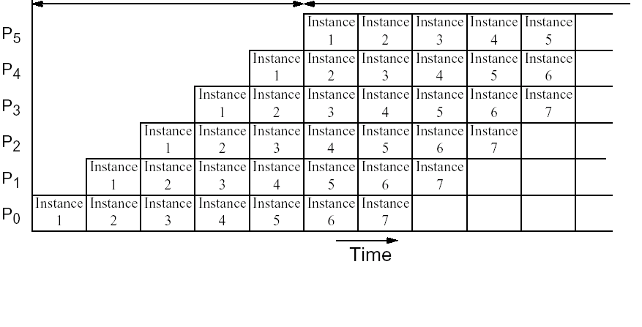
Type 1: Space-time diagram
p - 1
m
p-stage pipeline on p processors.
m instances of the problem.
Execution time = m + p – 1.

Slide 47
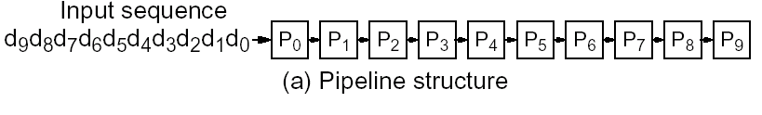
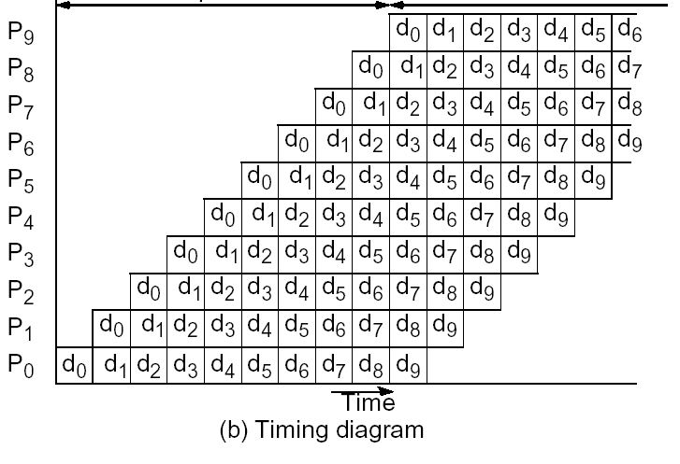
Type 2: Space-time diagram
p - 1
n
p-stage pipeline on p processors
n data items
Execution time = n + p - 1

Slide 48
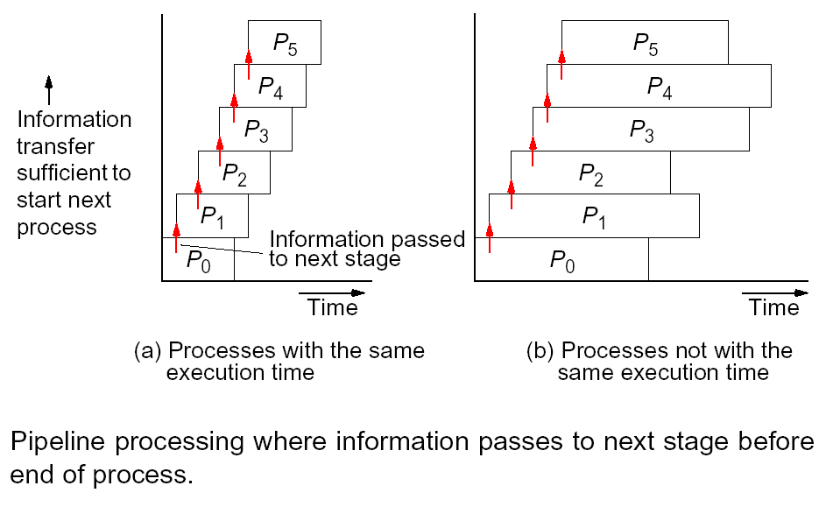
Type 3: Space-time diagram

Slide 49
Analysis of types 1 and 2
Assumptions and model
p processors performing p stages (tasks).
Each task consists of a number of cycles, i.e. basic units of computation.
All cycles of all tasks take about same amount of time, say t_{cycle}.
Parallel execution time t_{p} = t_{cycle}* n_{c}.
Time for one cycle t_{cycle} = t_{comp} + t_{comm}.
Number of cycles n_{c} given by space-time diagram.
For type 1, n_{c} = m + p – 1 for m instances.
For type 2, n_{c} = n + p – 1 for n data items.

Slide 50
Sum of sequence (type 1)
Power series sin θ = θ - θ³/3! + θ⁵/5! - θ⁷/7! + ...
θ
θ-θ³/3!
θ-θ³/3!+θ⁵/5!
θ-…±θ^{2p-1}/(2p-1)!
P₀
P₁
P₂
P_{p-1}
if (myrank == 0) /* first */
send(theta, theta, theta, P₁);
else /* not first */
recv(&theta, &r, &sum, P_{i-1});
r = – r*theta*theta/(2*i*(2*i+1));
sum = sum + r;
if (myrank < p-1 ) /* not last */
send(theta, r, sum, P_{i+1});
}
/* final result in P_{p-1} */

Slide 51
Analysis
Parallel execution
Use most complex cycle to upper bound computation time.
Computation time t_{comp} = 4.
Communication time t_{comm} = 2(t_{startup} + 3 t_{data}).
Time for one cycle t_{cycle} = t_{comp} + t_{comm}.
Single instance of problem
Number of cycles n_{c} = p for single instance.
Time t_{p} = t_{cycle}* n_{c} = p(2(t_{startup} + 3 t_{data}) + 4).
recv(&theta, &r, &sum, P_{i-1});
r = – r*theta*theta/(2*i*(2*i+1));
sum = sum + r;
send(theta, r, sum, P_{i+1});

Slide 52
Analysis
Pipeline is efficient only if we have more than one problem to solve, i.e. more than one value of θ.
Assume we compute sin for m values of θ.
Parallel execution
Number of cycles n_{c} = m + p - 1 for m instances.
Time t_{p} = t_{cycle}* n_{c} = (2(t_{startup} + 3 t_{data}) + 4) * (m + p - 1).
Average execution time per instance is t_{a} = t_{p} /m = O((m + p) / m).
For large m (i.e. continuous supply of values of θ) average execution time per instance is
t_{a} = 2(t_{startup} + 3t_{data}) + 4 = O(1).
A result is produced each constant number of pipeline cycles.

Slide 53
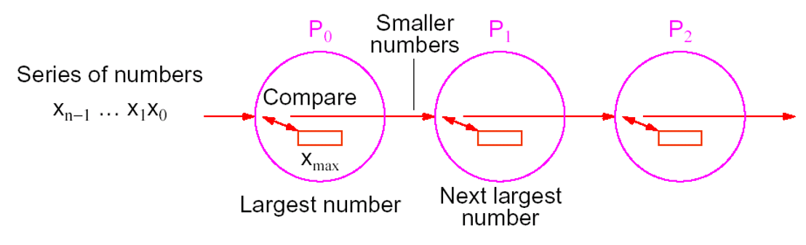
Insertion sort (type 2)
Use a pipeline to sort n numbers in decreasing order using p = n processors.
Each processor stores the largest number received so far and passes on all smaller numbers.
If a new number is larger than the currently stored number, the stored number is passed on and replaced by the new number
When all numbers have been passed through the pipeline, P₀ has the largest number, P₁ has next largest number, etc.

Slide 54
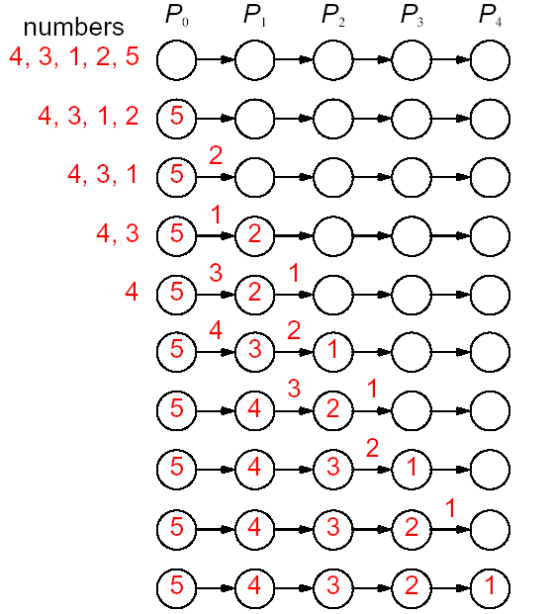
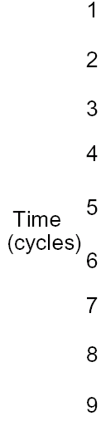
Insertion sort
2 steps
i) store
ii) compare/pass on

Slide 55
Insertion sort
Initialization and basic cycle for P_{i}.
x is current max value at P_{i}.
Process P_{i} needs to pass on (n - i - 1) numbers, as there are (n - i - 1) processors to its right.
It executes the basic cycle (n - i - 1) times.
recv(&number, P_{i-1});
if (number > x) {
send(x, P_{i+1});
x = number;
}
else
send(number, P_{i+1});

Slide 56
Analysis
Sequential execution
t_{s} = (n-1) + (n-2) + … + 2 + 1 = n (n-1) / 2 = O(n²).
Parallel execution
Each basic cycle consists of one recv, one send and a compare/exchange operation.
Computation time t_{comp} = 3.
Communication time t_{comm} = 2(t_{startup} + t_{data}).
Time for one cycle t_{cycle} = t_{comp} + t_{comm}
Number of cycles n_{c} = n + p - 1 = 2n – 1.
Time t_{p} = t_{cycle}* n_{c} = (2(t_{startup} + t_{data}) + 3) * (2n - 1) = O(n).

Slide 57
Solving linear equations (type 3)
Solving linear equations in upper (or lower) triangular form.
Used in Gaussian elimination.
Process P_{i} behaves as follows.
Receives partial solution from P_{i-1}.
Passes on partial solution to P_{i+1}.
Computes next part of solution and sends to P_{i+1}.
This is a type 3 pipeline computation.
Each process has a different computation time.

Slide 58
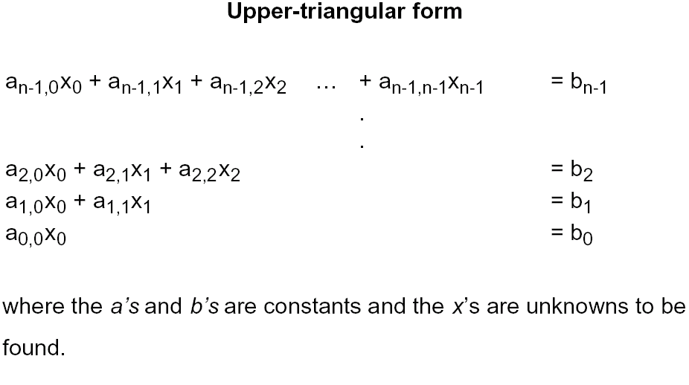
Solving linear equations

Slide 59
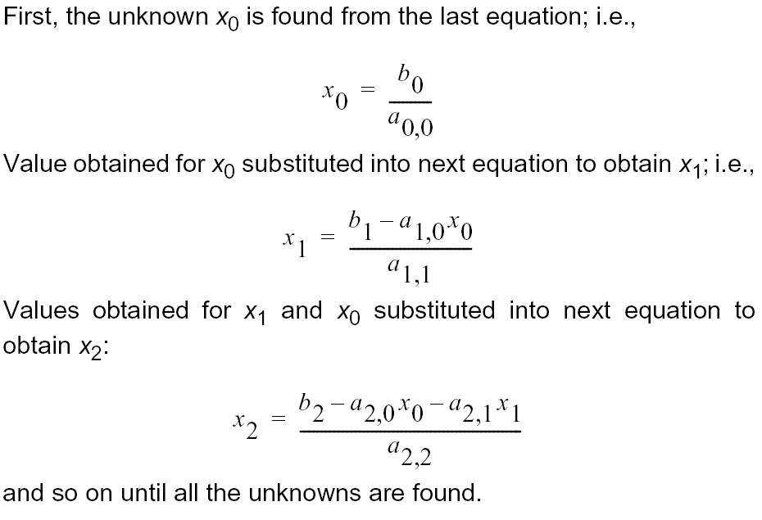
Back substitution

Slide 60
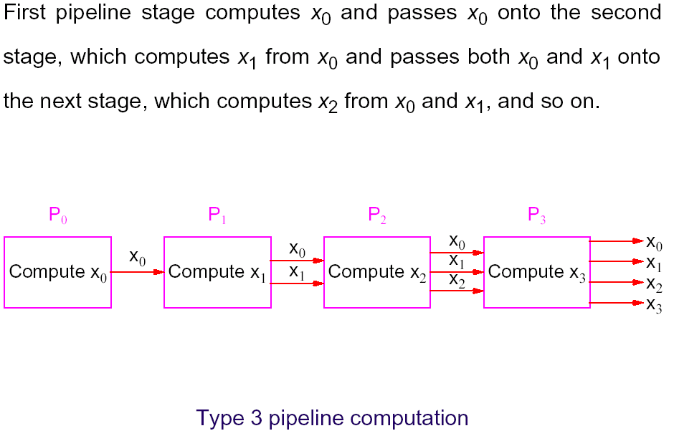
Pipeline solution
p = n
n equations
n unknowns

Slide 61
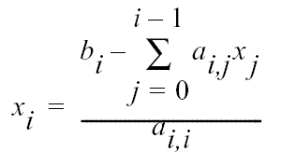
Parallel code
Process P_{i} (0 < i < n)
Process P₀
p = n stages, with final result on P_{n}.
sum = 0;
for (j = 0; j < i; j++) {
recv(&x[j], P_{i-1});
send(x[j], P_{i+1});
sum = sum + a[i][j]*x[j];
}
x[i] = (b[i] - sum)/a[i][i];
send(x[i], P_{i+1});
x[0] = b[0]/a[0][0];
send(x[i], P_{i+1});

Slide 62
Analysis
Sequential execution
Iteration i of loop performs i multiplications and additions, one subtraction and one division.
t_{s} = O(1+2+...+n-1) = O(n²).
Parallel execution
Process P_{i} performs i multiplications and additions, one subtraction and one division.
Process P_{i} has one recv and one send before process P_{i+1} can start, so time to pass data is 2(t_{startup} + t_{data}).
Process P_{n-1} starts at time (n - 1) * 2(t_{startup} + t_{data}).

Slide 63
Analysis
Parallel execution
Process P_{n-1} performs n - 1 multiplications and additions, one division and one subtraction.
Computation time t_{comp} = 2(n - 1) + 2.
Process P_{n-1} has (n - 1) recv and n send.
Communication time t_{comm} = (2n - 1)(t_{startup} + t_{data}).
Time t_{p} = (n - 1) *2(t_{startup} + t_{data}) + (2n - 1) (t_{startup} + t_{data}) + 2(n - 1) + 2 = O(n).
Speedup = t_{s} / t_{p} = O(n) with n processors.

